Slide 1
Managing Errors
Identifying and dealing with errors at runtime
Programming – Introduction to C#
Last modified 12/12/16 by Alex Mackay

Slide 2
Contents
Runtime Errors
Exceptions
Try-catch
Assert

Slide 3
Runtime Errors
Sometimes things go wrong with our program while it is running
Often that is because we have a logic error
Sometimes it’s out of our control!
In either case, there are tools to help us detect and handle errors

Slide 4
Runtime Errors
“Graceful degradation”
When something goes wrong our programs should still:
Behave as predictably as they can
Complete as much work as they can
Avoid losing data

Slide 5
Runtime Errors
We’re using C#
The concepts here apply to other languages too!
Including C++

Slide 6
Exceptions
Objects that describe when something has gone wrong
May contain data with details of the error
Eg: NullReferenceException is thrown when you try to use a reference that is currently set to null
All derive from class System.Exception

Slide 7
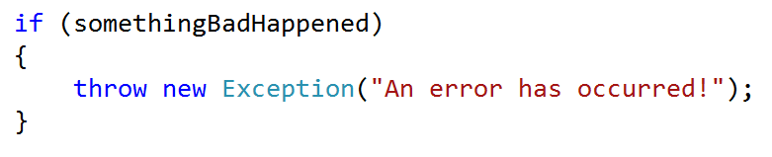
Exceptions
Exceptions are thrown when the error they represent is detected

Slide 8
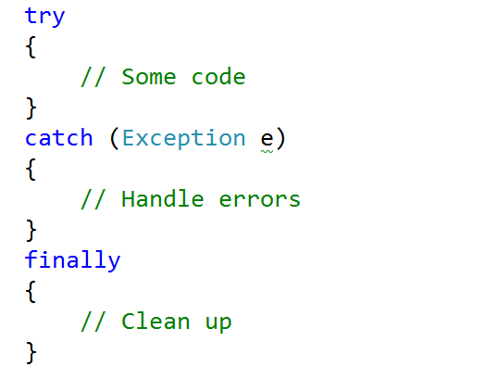
Try-catch blocks
Exceptions can be caught using a try-catch statement

Slide 9
Try-catch blocks
When we catch an exception we want to handle the error that caused it
Can we fix the error condition?
Can we perform our task in a different way?
Do we tell the user what went wrong?
An exception which is not caught is said to be unhandled

Slide 10
Assert
Wherever possible we want to identify and avoid logic which can lead to runtime errors
Assert functions are handy for this
An assert function:
Checks that a state is valid
Halts the program and shows if invalid states are reached
Only runs in debug mode

Slide 11
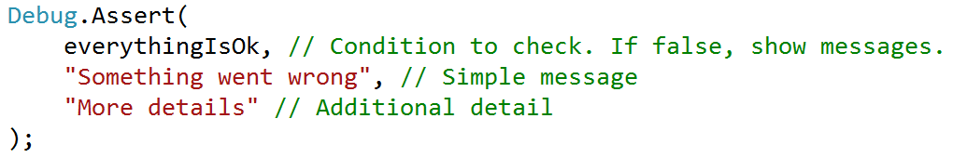
Assert

Slide 12
Summary
Exceptions are objects which describe an error which has occurred
They are “thrown” when the error is detected
Try-catch blocks allow us to “catch” exceptions to handle the error they describe
Assert functions help us to identify when invalid states occur so that we can change our logic to avoid them

Slide 13
Further Reading
Microsoft, C# Reference: Exception Handling, MSDN
https://msdn.microsoft.com/en-AU/library/ms173162.aspx
Microsoft, C# Reference: Debug.Assert method, MSDN
https://msdn.microsoft.com/en-us/library/system.diagnostics.debug.assert(v=vs.110).aspx

